Slide 1
H GH VOLTAGE

Slide 2



DEMO

Slide 3
5
4
3
2
1
START

Slide 4


Slide 5





Slide 6

House Of Starks

Slide 7





Slide 8






Extreme Exploders

Slide 9




Slide 10

Clueless

Slide 11




Slide 12

Corporate Criminals
Corporate Criminals

Slide 13




Slide 14

F
SQUARE

Slide 15




Slide 16
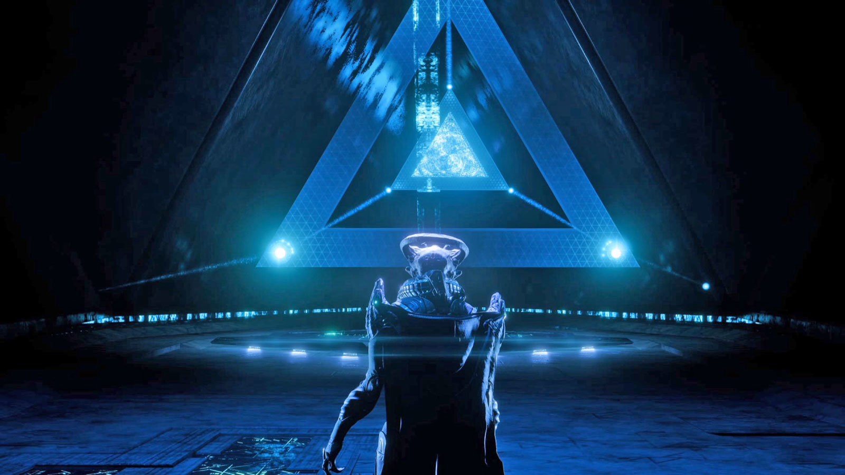
ANDROMEDA

Slide 17




Slide 18

Liquid

Slide 19




Slide 20


Slide 21




Slide 22
THANK YOU SO MUCH
HOPE YOU Enjoyed
Team-H GH VOLTAGE

